Slide 1
Leaf Disease Detection using svm and matlab
N. Shalini : 2451-16-737-002
A. Jyothi : 2451-16-737-008
K. Vinay : 2451-16-737-009
Guide : K. Devaki
Assistant Professor

Slide 2
Abstract
Agricultural productivity is something on which economy highly depends.
The plant leaf diseases have been effecting the productivity, quality and efficiency of the plants. To overcome this, the plant leaf diseases are to be recognised during the initial stages.
The proposed project is based on the Image processing technique using Matlab, where the pictures of the leaves are given as the input to the system. Four kinds of diseases are identified viz., Alternaria Alternata, Anthracnose, Bacterial Blight, Cercospora.
The images are used to train the data sets and support vector machines, and correspondingly the diseases are identified based on the trained dataset.

Slide 3
Introduction a. Problem Statement
One of the most important sector of the economy is agriculture.
Farmer’s economic growth relies on the quantity of the products they produce, which depends on the plants growth and yield they get.
Plants are highly prone to diseases which in turn reduces the yield of the crop. Thus, Detection of the plant diseases plays an important role in farming. But manual detection is a tedious job.
Hence, Automatic detection of plant diseases is essential as it may prove benefits in monitoring large fields of crops, and thus detect the symptoms of diseases as soon as they appear on plant leaves.

Slide 4
b. Requirement Specification
Hardware specification:
Windows-64 bit , Intel core processor
Software specification :
Matlab: R 2014 a

Slide 5
Literature Survey
The different classification techniques used for plant leaf disease classification were proposed by using some classification techniques like k-Nearest Neighbour Classifier, Probabilistic Neural Network, Genetic Algorithm and Principal Component Analysis, Artificial neural network, Fuzzy logic.
But, the accuracy of most of the results were below 90% only. Experimental results showed the classification action by ANN taking feature set is better with an precision of 91%.
The proposed system is to detect the plant leaf disease at early stage with 96% accuracy by using Support Vector Machines.

Slide 6
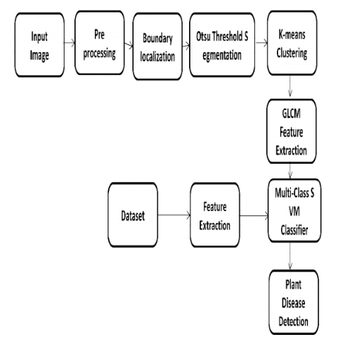
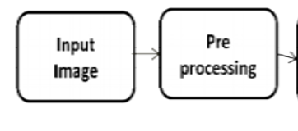
Flow Chart

Slide 7
OVERVIEW
The input image is pre-processed by converting the image to black and white image.
The second stage is the segmentation, which uses the OTSU Segmentation to contrast and enhance the pre-processed image.
The third step is to cluster the image according to the contrast colour using the K-means clustering.
Fourth step is the feature extraction, which uses GLCM feature extraction for extracting the clustered images.
Fifth phase is the classification of images using Multi-Class SVM from the extracted images. Finally, the five phases also done for datasets.
The comparison was done for result set and data set, after all the disease name, accuracy and affected percentages was calculated.

Slide 8
Implementation
Step 1: Pre-Processing :
The input image was resized to 256 X 256.
A coloured image was enhanced to the contrast colour.
Step 2: OTSU Segmentation:
Thresholding (A simplest form of Image segmentation) is done using Otsu’s method which converts the intensity image to binary image. We Convert the RGB image format to a grey-scale image.

Slide 9

Otsu method works on a simple idea: Find a threshold that minimizes the within class variance and maximizes the between class variance.
Manually detecting the threshold from histograms is tricky and it may lead to inaccurate outputs.
So, Otsu method uses “graythresh() ” function that automatically detects the threshold value for a corresponding histogram.
This method assumes that a histogram is bimodal.

Slide 10



Level = graythresh(I) computes a global threshold (level) that can be used to convert a color image to a binary image with “im2bw.” A level is a normalized intensity value that lies in the range [0, 1].
Here, each pixel is replaced with a black pixel (0) if the pixel threshold is less than constant., and with white(1) if it is greater than constant.

Slide 11
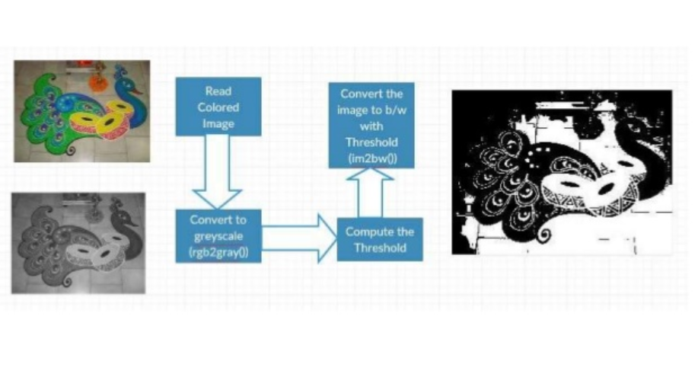
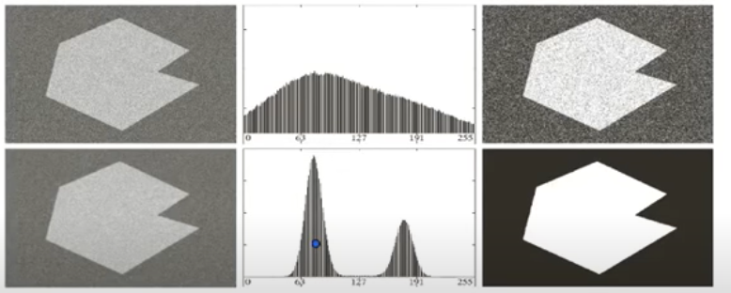

Slide 12
CLUSTERING:
Clustering is the task of dividing the population into number of groups such that data points in the same group are more similar to other data points in that same group than those in the other groups.
These groups are called Clusters.
The clustering we are going to apply here is K-means clustering where K denotes number of clusters.
K-means is a distance based algorithm and is an efficient method.

Slide 13
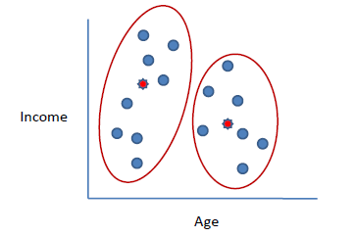
K-MEANS CLUSTERING:
K-Means clustering intends to partition n objects into k clusters in which each object belongs to the cluster with the nearest mean.
This method produces exactly k different clusters of greatest possible distinction. The best number of clusters k leading to the greatest separation (distance) is not known as a priori and must be computed from the data.
The advantage of using K-means algorithm is that it is simple and easy to understand.

Slide 14
SYNTAX:
idx = kmeans(X,k)
- partitions into K clusters
idx = kmeans(X,k,Name,Value)
- returns the cluster indices
[idx,C] = kmeans(___)
- returns K clusters centroid locations
[idx,C,sumd,D] = kmeans(___)
- returns distances from each point to every centroid.

Slide 15
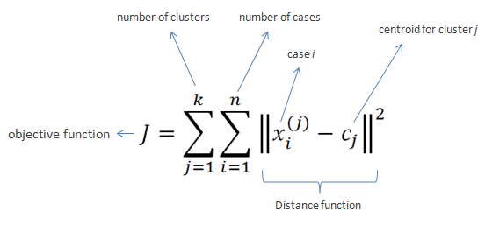

Slide 16
ALGORITHM:
Clusters the data into k groups where k is predefined.
Select k points at random as cluster centers.
Assign objects to their closest cluster center according to the Euclidean distance function.
Calculate the centroid or mean of all objects in each cluster.
Repeat steps 2, 3 and 4 until the same points are assigned to each cluster in consecutive rounds.

Slide 17
Contn..
K-Means is relatively an efficient method.
A practical approach is to compare the outcomes of multiple runs with different k and choose the best one based on a predefined criterion.
In general, a large k probably decreases the error but increases the risk of overfitting.

Slide 18
PROPERTIES:
In each given cluster at least one item should be present.
Overlapping of clusters should never happen.
Every participant of the single cluster should be close to its own cluster than any other cluster.
There should be more than 1 number of clusters so that the problem of over fitting decreases.

Slide 19
GLCM FEATURE EXTRACTION
What is feature extraction?
Feature Extraction is a method of capturing visual content of images for indexing & retrieval.
Primitive or low level image features can be either general features, such as extraction of color, texture and shape or domain specific features.
Gray Level Co-occurrence Matrix (GLCM) is used to extract second order statistical texture features namely, Angular Second Moment, Correlation, Inverse Difference Moment, and Entropy .

Slide 20
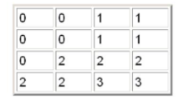
GLCM OPERATION FOR FEATURE EXTRACTION:
In the second order, measures are used to consider the relationship between groups of two pixels (usually neighboring) in the image to generate features.
The values of co-occurrence matrix elements present relative frequencies with which two neighboring pixels separated by distance d appear on the image where one of them has gray level i , and other has j.

Slide 21
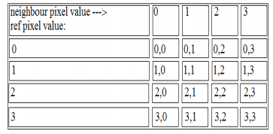
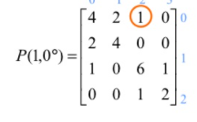
GLCM of an image is computed using a displacement vector d, defined by its radius δ and orientation θ.
GLCM does the analysis in different orientations like Horizontal (0degrees), Vertical (90degress) etc.

Slide 22
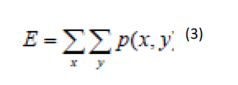

After obtaining the count matrix we need to normalize it in order to find the probabilities.
After the construction of the matrix,meaningful statistics are extracted from features like Energy, Entropy, Contrast, Correlation, Homogenity etc.
Energy:
Contrast:

Slide 23
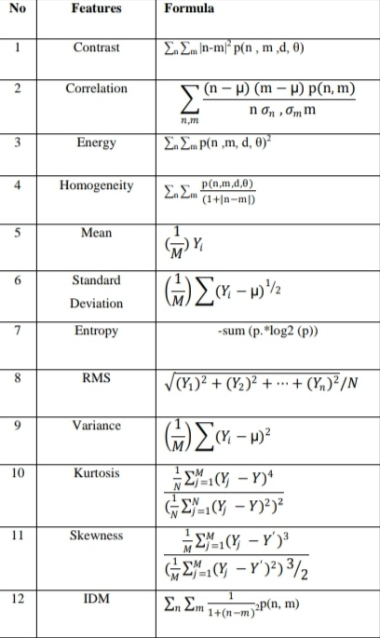
The features we considered and the formulae to obtain those features are given in below table:

Slide 24
Finally, a vector of each image sample on the database was produced. The resultant vectors then will be saved in the memory in indexing feature vector which contains the indexes to both the names and the images of training database.

Slide 25
Multiclass SVM definition and benefit over standard svm:
SVM(Support Vector Machine)s are supervised Machine Learning models used for classification and regression analysis.
Generally SVMs are applied to two classes available ,but in real life problems multi classes are required, so we use multi class SVMs.
Multi Class SVM forms multiples of two class classifiers based on the feature vector derived from the input features and the class of the data.

Slide 26
USE OF MULTICLASS SVM FOR CLASSIFYING OBJECTS:
The Support Vector Machine uses decision planes that defines the decision boundaries/hyper planes.
Some of the problems of the texture classification makes use of the SVM classifier. The high dimensional space in SVM is performed by mapping nonlinear data into linear form.
The maximum width at the plane distance is largest between the different classes using SVM classify. The classes are divided into the different kernels methods.
Linear classifier is used to examine the hyper plane and the samples which are closer to the plane will be chosen. The multiclass classification either uses the one-to-one or one-to-many.

Slide 27
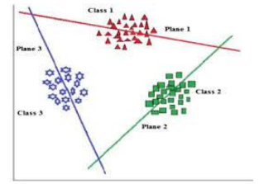
The training samples are used in the SVM classifier.
A standard format of the SVM solves two class problems. From the binary problems can be extended to multiclass SVM with K classes. Where K>2.
Here we are using one versus all approach where k 2 class classifiers are constructed. The ith SVM is trained while labeling all the the samples in the ith class as positive and all others as negative.
The main reason for using one vs all is we can use the entire dataset for each label which will potentially reduce variance in estimate of parameters.

Slide 28
The predefined functions we have for svm training and classification are:
SvmStruct=svmtrain(Training,Group)
where, training=matrix of training data,
group=column vector for classifying data in training into g groups.
Classes=svmclassify(SVMStruct,Sample)
where,sample is the test data

Slide 29
Training:
1. Start with images of which classes are known for sure.
2. Find the property set or feature set for each of them and then label suitable.
3. Take the next image as input and find features of this one as new input.
4. Implement the binary SVM to multi class SVM procedure.
5. Find the class of the input image.
6. Depending on the outcome species, the label to the next image is given. Add the features set to the database.
7. Steps 3 to 7 are repeated for all the images that are to be used as a database.
8. Testing procedure consists of steps 3 to 6 of the training procedure. The outcome species is the class of the input image.

Slide 30
Accuracy Calculation:
Intially our dataset with 125 images is split into training set and testing set.
For accuracy calculation we use every image from the testing set and apply the below formula:
Accuracy(%)=(No.of correctly classified/Total no.of leaves in the dataset)*100
The highest accuracy we obtained is 98.2%.

Slide 31
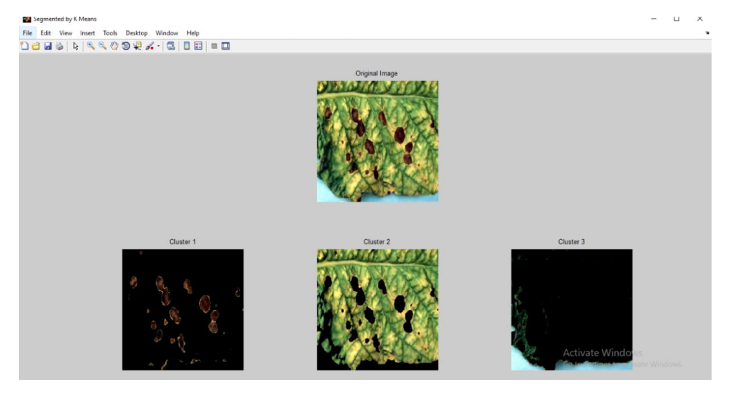
OUTPUT:

Slide 32
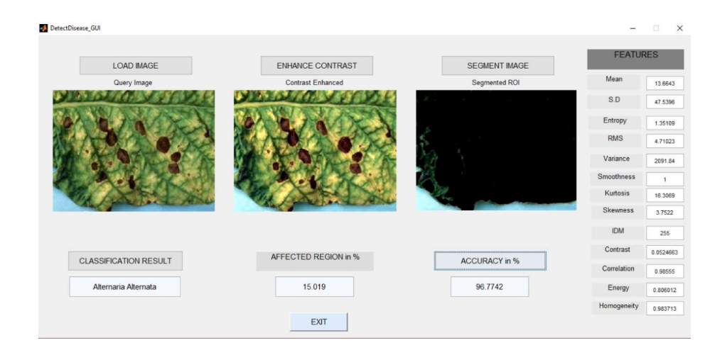

Slide 33
CONCLUSION
This project gives the executed results on four kinds of diseases.
SVM classification technique has proved to give the most effective results for plant leaf disease detection and an algorithm for image segmentation technique used for Automatic detection as well as classification of plant leaf diseases has been clearly demonstrated.
From these methods, we can accurately identify and classify various plant diseases using image processing techniques with a maximum accuracy of 98.2%.

Slide 34
Scope of work
The performance of the system can be improved in the future by using advanced background separation methods to separate the leaf object from a complex background.
More infections like downy mildew (DM) and sudden death syndrome (SDS) can also be classified.
The similar methodology can be applied to other plant infections and early warning systems for rice, cotton-crops, fruits, vegetables and beans, etc.

Slide 35
References
Mrunalini R Badnakhe,DeshmukhPrashant R.An application. Of K- means clustering and artificial in pattern recognition for crop disease .Int Find Adv INF Technology 2011;20.2011 IPCSIT.
http://www.journal4research.org/articles/J4RV2I2033.pdf
http://www.ijircce.com/
https://www.researchgate.net/publication/337021336_Glcm_Based_Plant_Leaf_Disease_Detection_Using_Multiclass_SVM
Detection of plant leaf diseases using image segmentation and soft computing techniques by Vijai Singh a,*, A.K. Misra b.
http://www.Wsease.com

Slide 36
https://onlinelibrary.wiley.com/doi/pdf/10.1111/1556-4029.13938
http://web-ext.u-aizu.ac.jp/course/bmclass/documents/otsu1979.pdf
https://www.researchgate.net/post/Which_thresholding_techniques_are_better_if_our_image_has_Intensity_homogeneities
www.journalforresearch.org
Leaf Disease Detection using Clustering Optimization and Multi-Class Classifier DR.S. BHUVANA 1, KAVIYA BHARATI B 2, KOUSIGA P 3,RAKSHANA SELVI/
Journal homepage: www.elsevier.com/locate/inpa
Digital image processing https://www.youtube.com/user/Alfred936

